Slide 1

Assignment 8 midterm project
Brayden stubbs, sam Beasley, aaron anderson

Slide 2
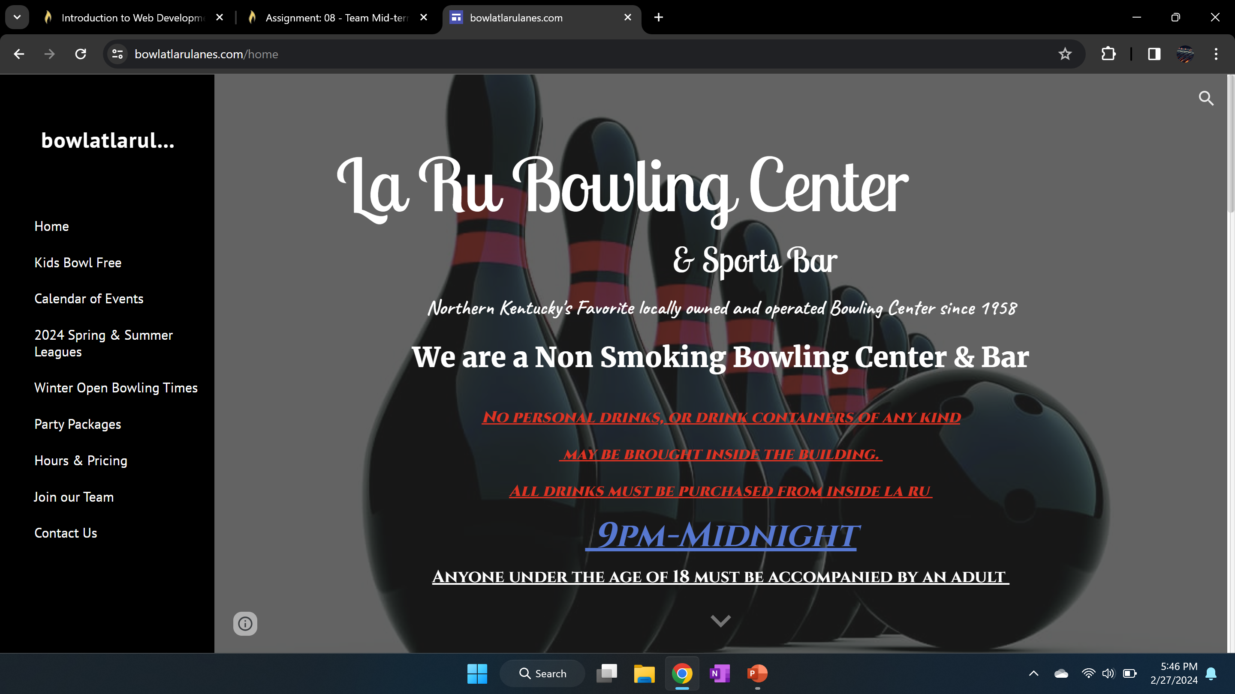
https://www.bowlatlarulanes.com/home

Slide 3
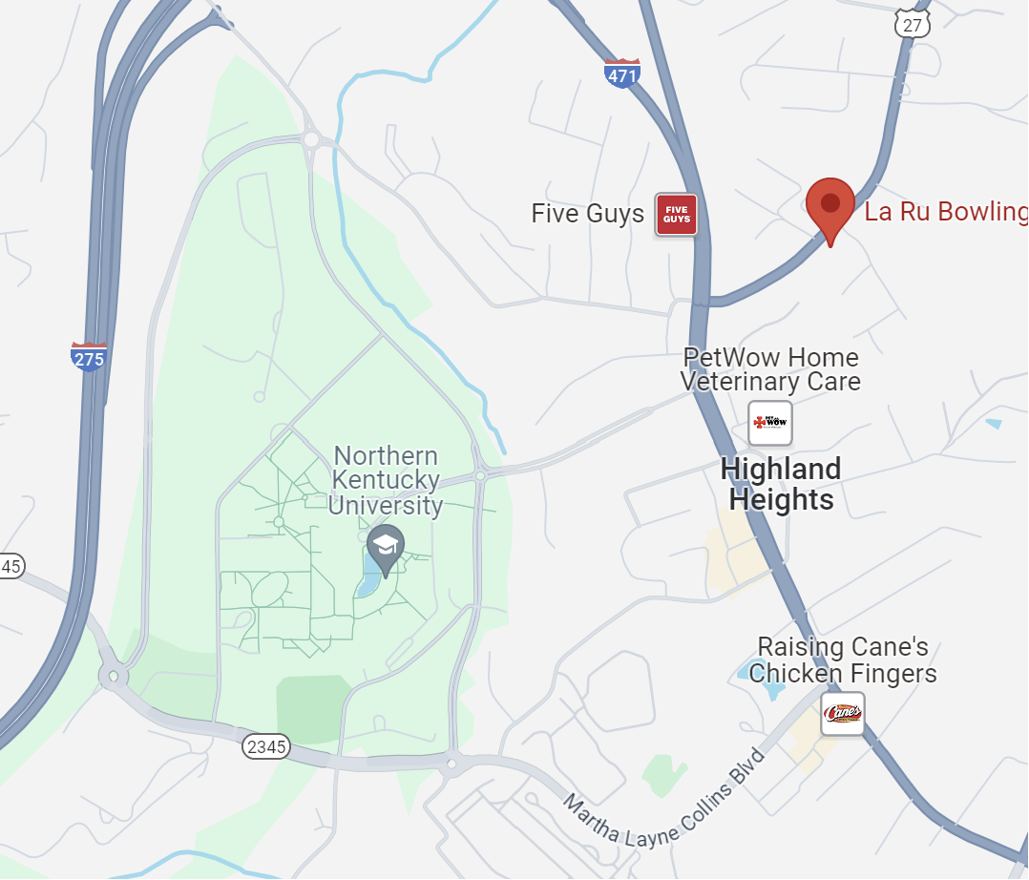
This website is the business website for La Ru bowling lanes in Highland Heights
We chose this website because it has many flaws and could use a lot of work to be considered “Well Done”
The following slides represent some of the problems that we found with this website.

Slide 4
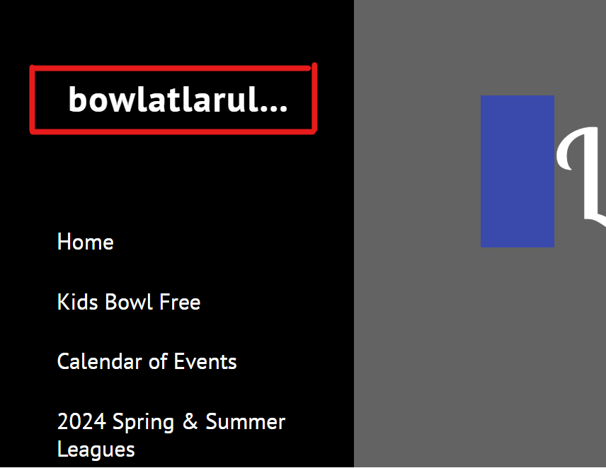
Problem 1
Bad Title
The title to the website isn’t fully visible. Upon inspecting the HTML, you can see that this element is the following:
<span>
bowlatlarulanes.com
</span>
The entire text that is supposed to be included in the span element is not present in the website. This is a problem.

Slide 5
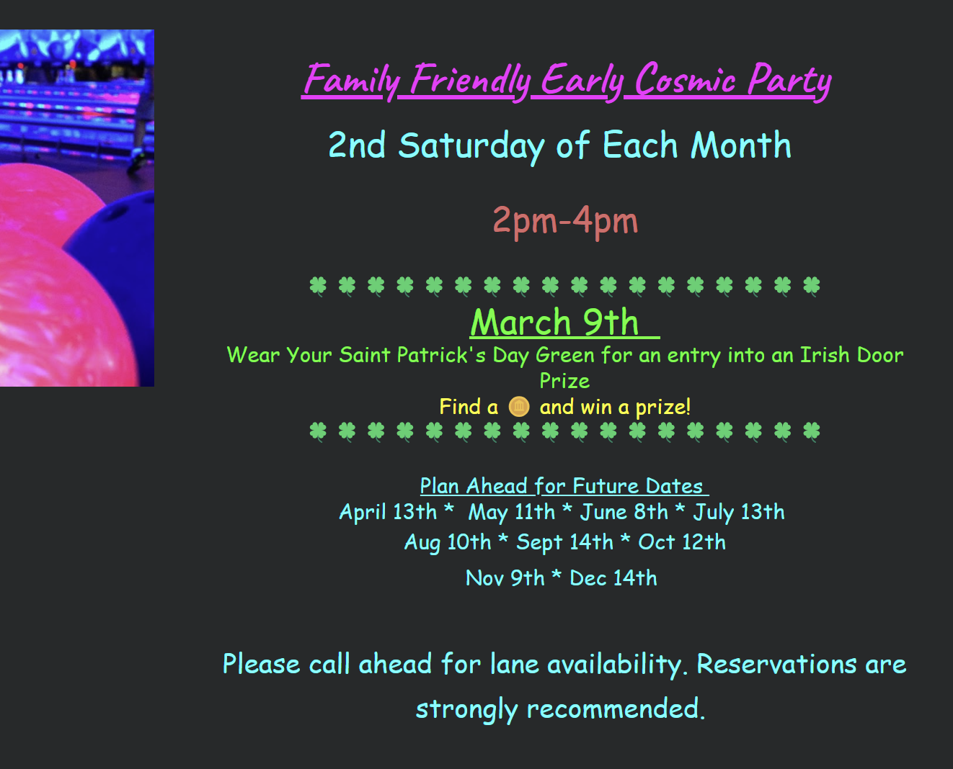
Problem 2
Bad color Pallet.
The color pallet used within the website is extremely obnoxious and inconsistent.
This website is for that of a local business, and it does not show professionalism in the slightest with the color choices they have made. Not to mention, extremely bright colors can be visually overwhelming and therefore hard on the eyes of readers.

Slide 6
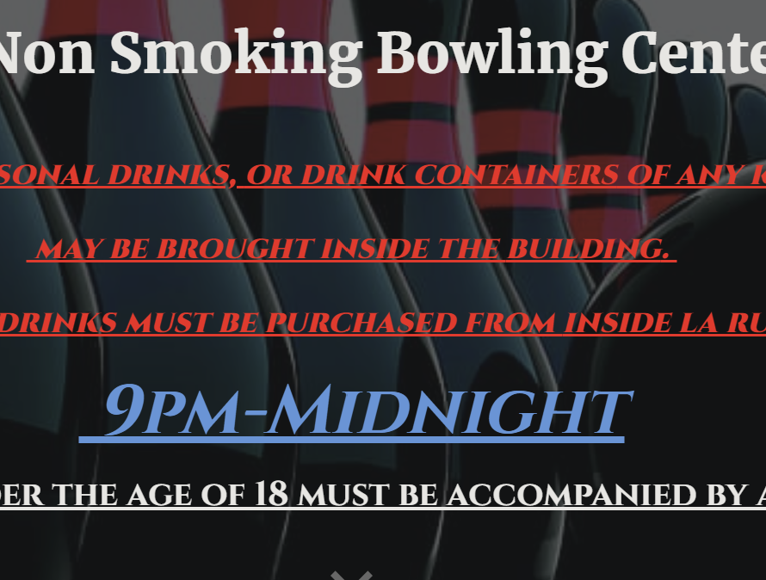
Problem 3
Overuse Of Underlining
There are multiple examples within this website of the overuse of the underlining text function.
This can cause a number of different issues, but most primarily creates confusion with hyperlinks. Traditionally, underlined text is associated with hyperlinks. If underlines are overused, the end user cannot differentiate from regular text and hyperlinks. Therefore, causing confusion and frustration.

Slide 7
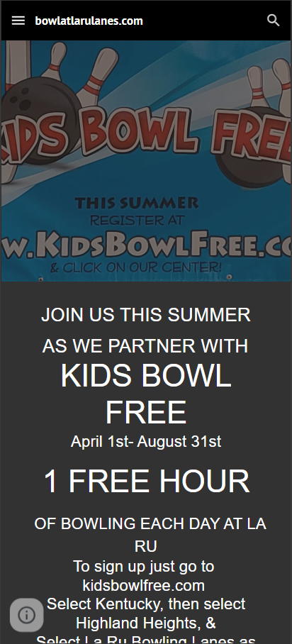
Problem 4
Non-responsive elements
Some elements don’t scale properly when viewed on mobile. For instance this banner gets cut off and you lose information due to improper scaling to vertical aspect ratios.

Slide 8
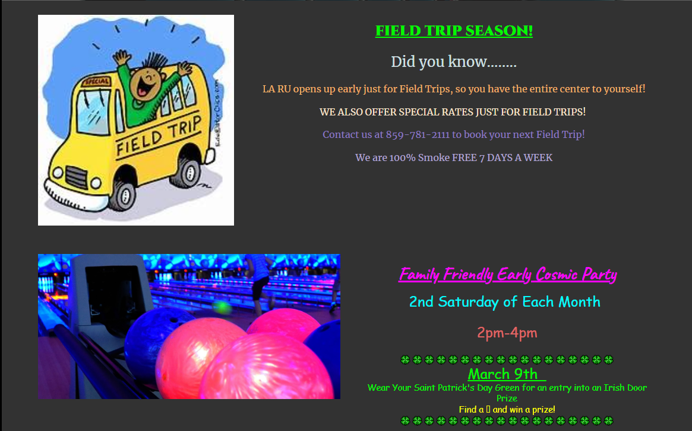
Problem 5
Low Quality Images
Some images such as this child in a school bus look outdated and cheap. This conveys to visitors a lack of time and effort. Consider purchasing some stock photos.
Some images are just pasted in without a border or rounding. Leading to an outdated aesthetic.

Slide 9
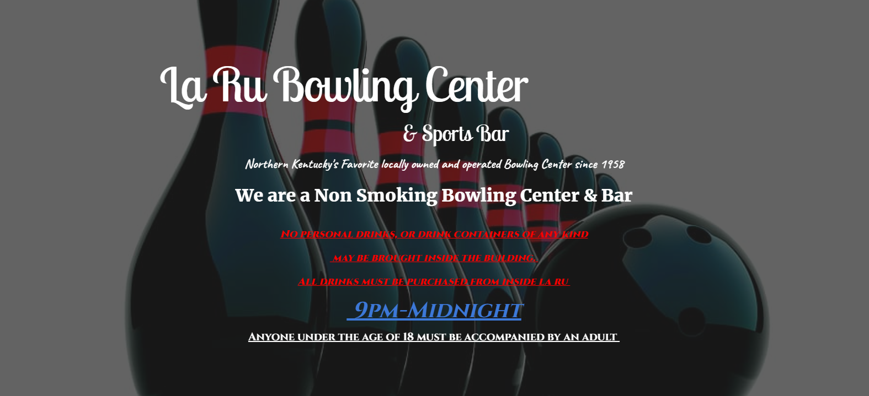
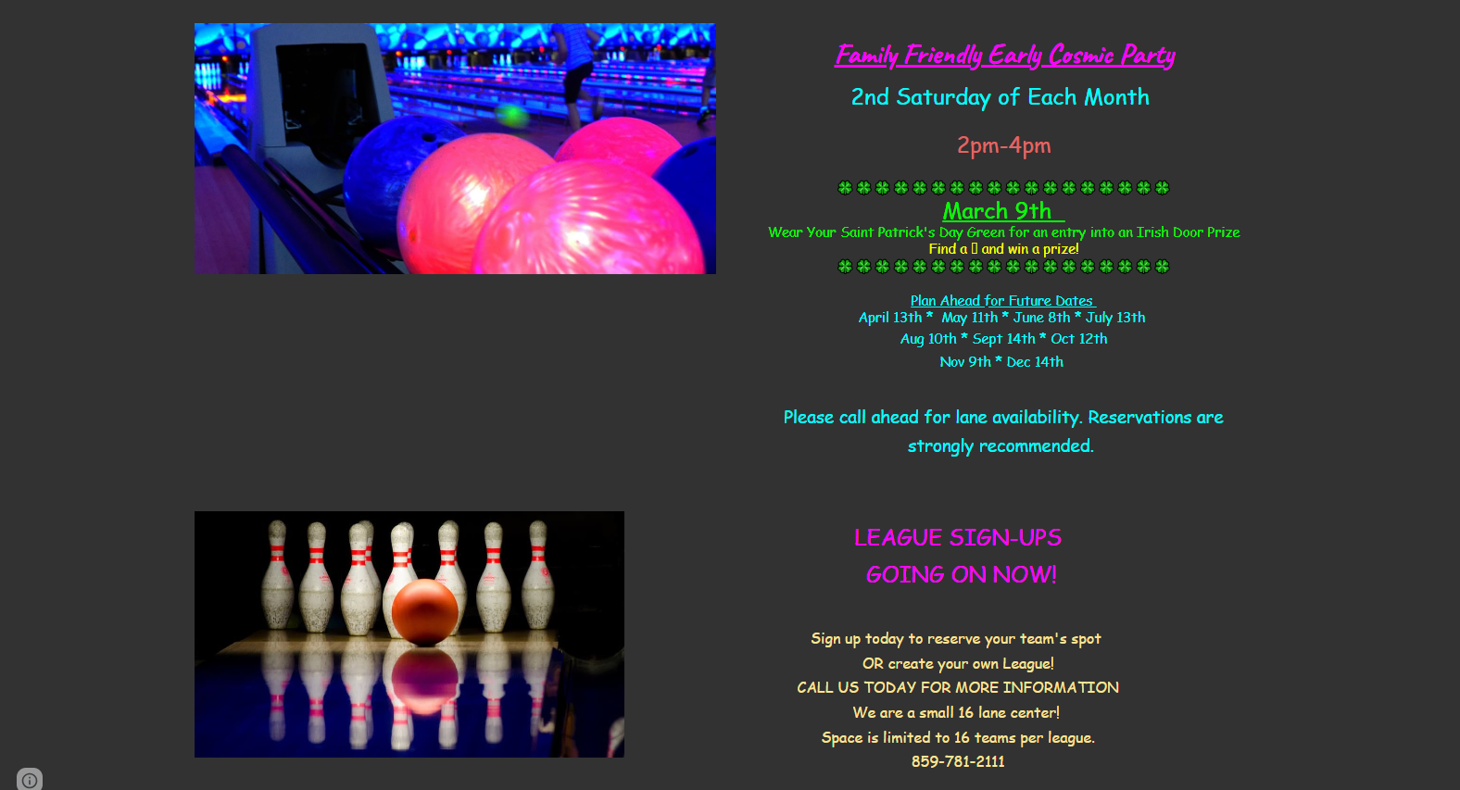
Problem 6
Lack of Brand Identity/Cohesion
The home page which is supposed to establish the identity of the brand is cluttered and is not cohesive throughout. It begins with a somewhat respectable font aesthetic but is then immediately met with what can be only described as obnoxiously neon.

Slide 10
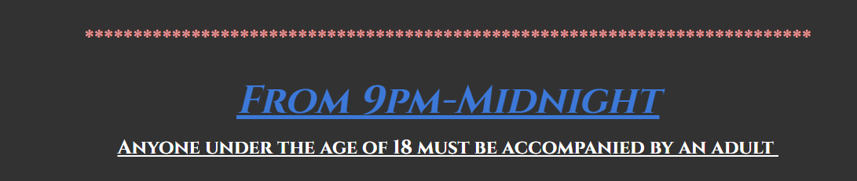
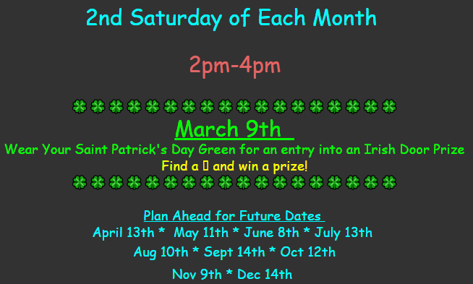
Problem 7
Improper line breaks
They use either emojis or special characters to represent lines to break up sections of multiple web pages.
They could instead use <hr> to form a line easier.
In special cases like for St. Patrick's day, it is more acceptable; however in general, using special characters isn't as efficient and makes is look clunkier.

Slide 11
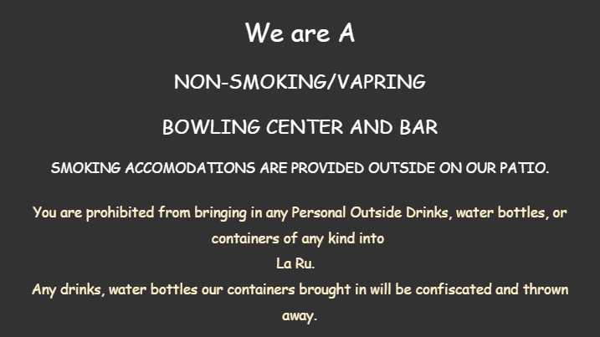
Problem 8
Text Formatting
Their formatting for text makes the sentences look incomplete and unreadable.
Spelling mistakes make the webpage look very unprofessional.
Most of the texts are centered in the page, which is usually okay because of mobile, but it makes the page look empty on web.
Improper capitalization.

Slide 12
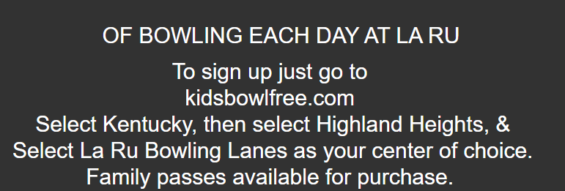
Problem 9
Missing embedded link
As previously stated, they use a lot of unnecessary underlines; however, when an underline is actually acceptable, there is not one to be found.
They put the url for a link that they promote; however it isn't linked to the actual website.
If they were to add a hyperlink to text, then they should add a way to make the hyperlink standout.

Slide 13
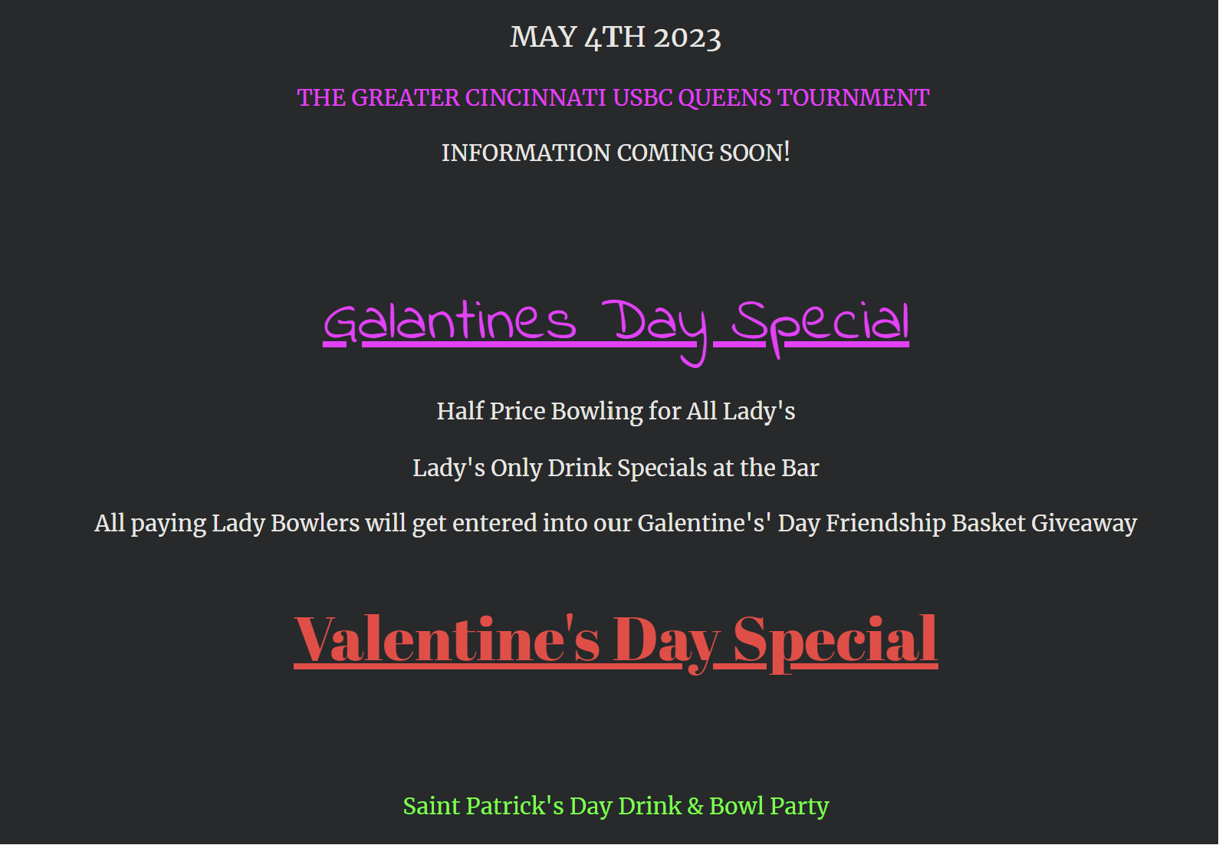
Problem 10
Visual Inconsistency
Using multiple different fonts right next to each other means that you are using characters with different styles, weights, characteristics, etc. side by side.
This makes the website design look disjointed or cluttered. A cohesive visual style is important for creating a professional and polished appearance.
Not to mention, doing so can decrease readability significantly.

Slide 14

Thank you!

